Slide 1

Data mining for listings
https://www.airbnb.ie/rooms/44077

Slide 2
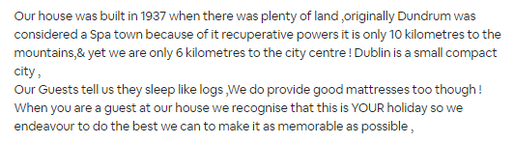
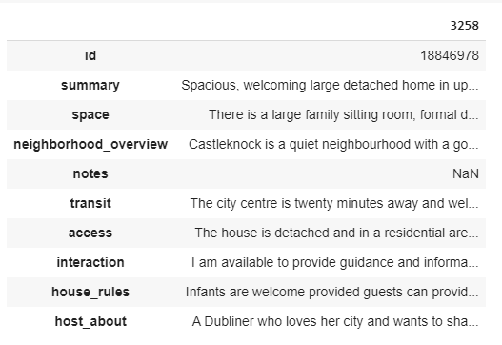
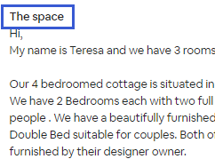
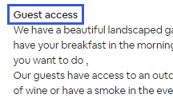
Data Understanding

Slide 3
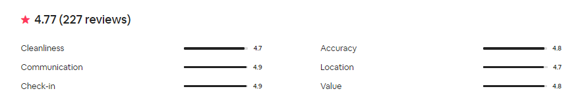
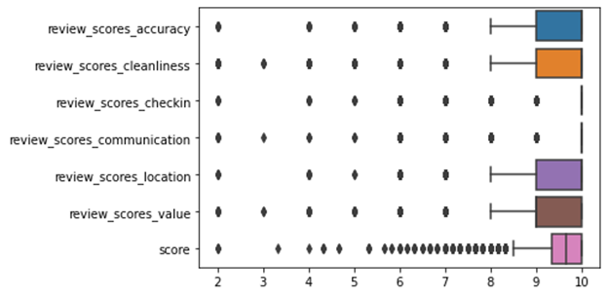

Slide 4
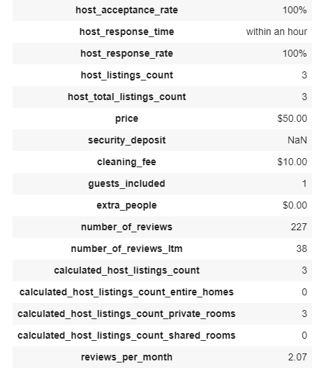
Preprocessing on Numeric Data on host page
Removal of the special symbol (‘%’ and ‘$’ in percentage and currency values)
Processing missing value
Standardize features by removing the mean and scaling to unit variance
Split dataset into random train and test subsets

Slide 5
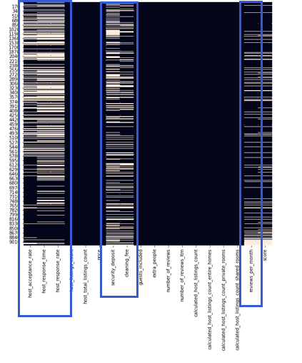
Columns with Missing Values
Discarded
host_acceptance_rate
host_response_time
Host_response_rate
reviews_per_month
Fillna with 0
Security_deposit
Cleaning_fee

Slide 6
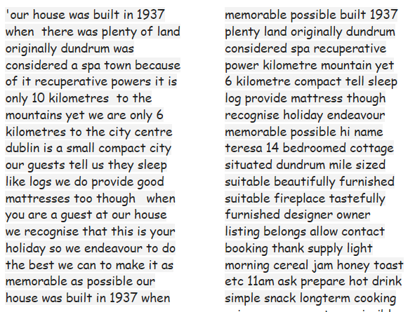
Preprocessing and Feature Engineering on Text
Preprocessing
Combine the nine parts
Lowercasing
Removal of Punctuation
Removal of StopWords
Removal of Unusual Characters
Removal of Common/Rare Words
Lemmatization

Slide 7
Features from Texts
Frequency-based Embedding
Count Vector
TF-IDF Vector
Word-Level
N-gram Level
Character N-gram Level
NLP-based Feature
Words Count
Characters Count
Average Word Length
Stopwords Count
Numerics Count
Noun Count
Verb Count
Adjective Count
Adverb Count
Pronoun Count
Sentiment Values
Vader Sentiment Intensity Analyzer
Negative Value
Neutral Value
Positive Value
Compound Value

Slide 8
Modeling on Numeric Features
NLP-based Features
Sentiment Values
Numeric Data on host page
KNeighborsClassifier
LogisticRegression
Support Vector Machine
Stochastic Gradient Descent
Random Forest Classifier

Slide 9
Modeling on Word Embedding Features
Naïve Bayes Classifier
MultinomialNB
ComplementNB
Logistic Regression
Support Vector Machine
Frequency based Embedding
Count Vector
TF-IDF Vector
Word-Level
N-gram Level
Character N-gram Level

Slide 10
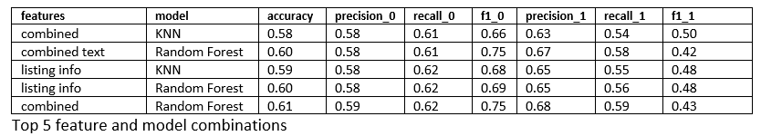
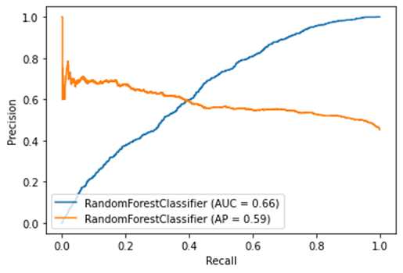
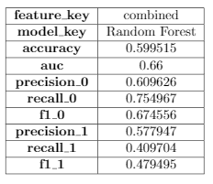
Evaluation on Numeric Features
after hyperparameter tuning

Slide 11
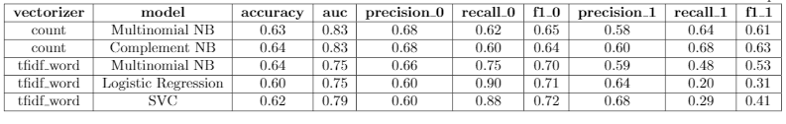
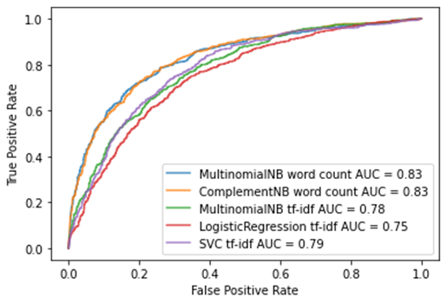
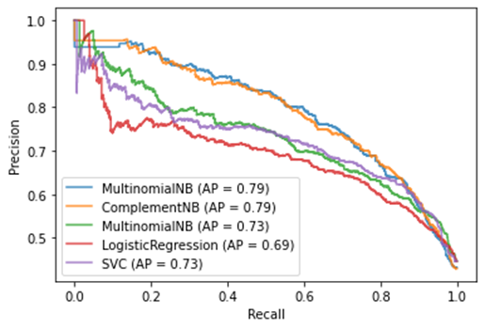
Evaluation after hyperparameter tuning

